Slide 1
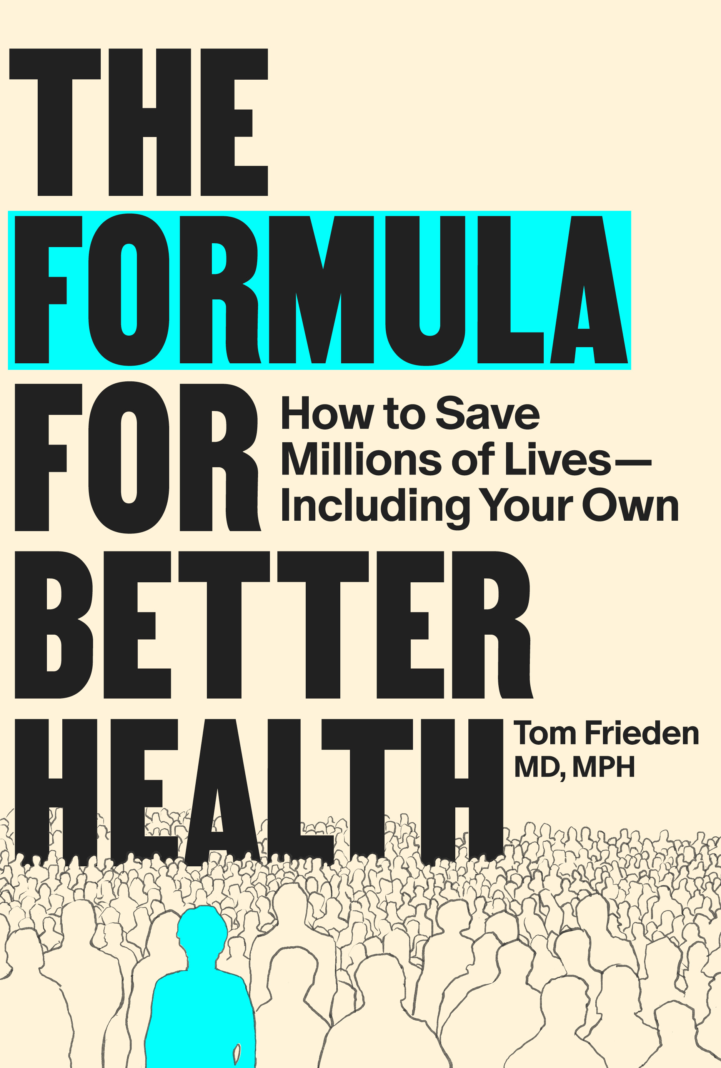
THE FORMULA FOR BETTER HEALTH · CASE STUDY: SMALLPOX ERADICATION
Who woke up this morning thinking about smallpox?
That silence is the lesson.
SEE
BELIEVE
CREATE
The disease that killed more than half a billion people is gone — and almost no one alive today knows it existed, or how it was beaten.
Public health success makes itself invisible.
Case Study · Smallpox Eradication · The Formula for Better Health
The Formula for Better Health · MIT Press, 2025 · theformulaforbetterhealth.net/formulateaching

Slide 2
SEE
BELIEVE
CREATE
THE FORMULA FOR BETTER HEALTH · CASE STUDY: SMALLPOX ERADICATION
The World in 1967
Before eradication: the scale of the problem · ~10 million cases per year at peak
300M -500M
~30%
>30
people killed by smallpox
in the 20th century alone
case fatality rate —
higher in children
countries with active
outbreaks in 1967
The prevailing strategy: vaccinate everyone, everywhere.
Mass vaccination required huge quantities of vaccine — often unavailable in endemic countries. WHO set the goal of global eradication in 1967. Most experts thought it was impossible.
Behbehani AM. The smallpox story: life and death of an old disease. Microbiological reviews. 1983 Dec;47(4):455-509.
Berche P. Life and death of smallpox. La Presse Médicale. 2022 Sep 1;51(3):104117
The Formula for Better Health · MIT Press, 2025 · theformulaforbetterhealth.net/formulateaching

Slide 3
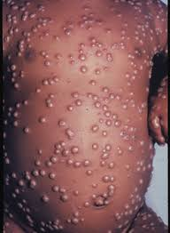
SEE
BELIEVE
CREATE
THE FORMULA FOR BETTER HEALTH · CASE STUDY: SMALLPOX ERADICATION
What Was Smallpox?
The disease students have never seen — and never will
Cause
Variola virus — infects humans only. No animal reservoir.
Progression
Fever and backache → distinctive pustules covering face and body, all at same stage.
Spread
Close contact and respiratory droplets. Each case infected 5–7 others.
Fatality
~30% of unvaccinated cases died. Death in the second week.
Incubation
7–17 days (average 12). Not contagious until rash appears — giving time to act.
Survivors
Permanent scarring, worst on face. Blindness in up to 35–40% with eye involvement.
CDC
Key: Lesions are unmistakable — every case is findable. That visibility is the strategic foundation of everything Foege built.
The Formula for Better Health · MIT Press, 2025 · theformulaforbetterhealth.net/formulateaching

Slide 4
SEE
BELIEVE
CREATE
THE FORMULA FOR BETTER HEALTH · CASE STUDY: SMALLPOX ERADICATION
Foege's Insight: Think Like the Virus
Nigeria, late 1960s — a vaccine shortage forces a new question
"If I were a smallpox virus, how would I move?"
Visible lesions
Long incubation period
No animal reservoir
Obvious pustules meant every case was findable without laboratory tests.
7–17 days gave time to vaccinate contacts before they became infectious.
Smallpox lived only in humans. Break human chains — disease disappears.
Better information substituted for larger resources — but only because biology permitted it.
The Formula for Better Health · MIT Press, 2025 · theformulaforbetterhealth.net/formulateaching

Slide 5
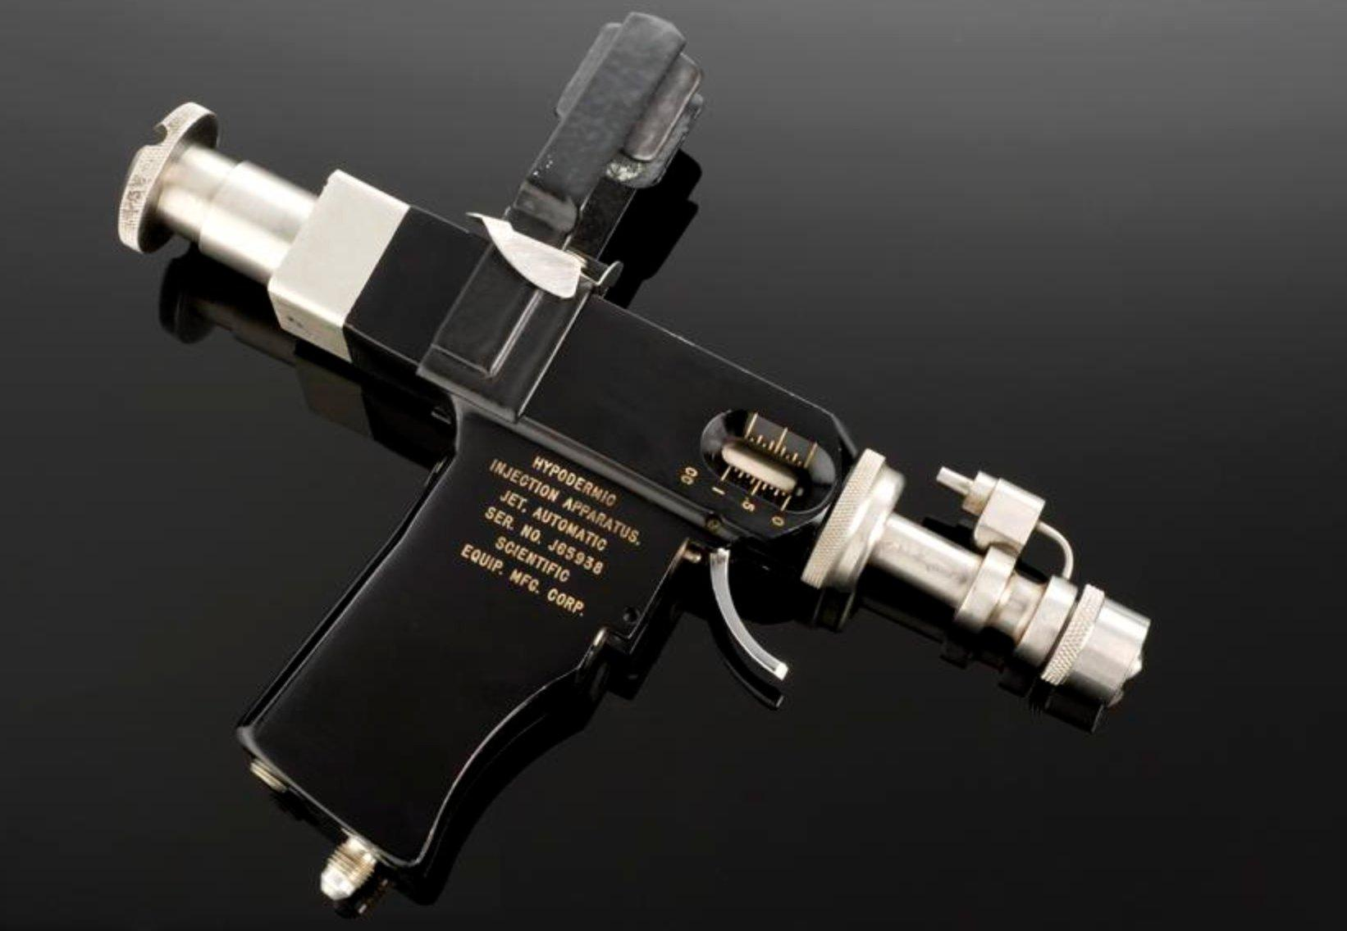
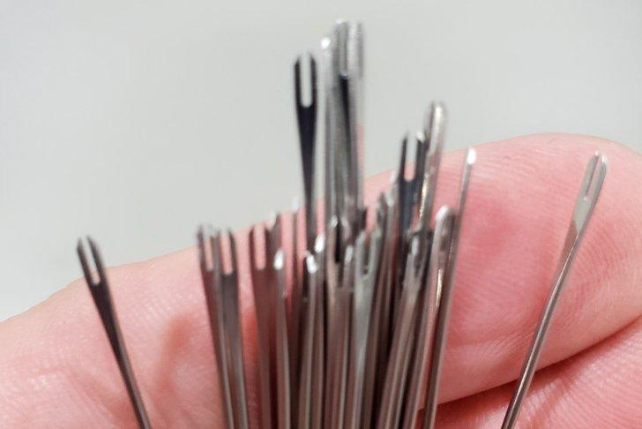
SEE
BELIEVE
CREATE
THE FORMULA FOR BETTER HEALTH · CASE STUDY: SMALLPOX ERADICATION
Two Tools, Two Strategies
Simplicity is a design principle, not a compromise
Jet Injector · Mass Vaccination Era
Bifurcated Needle · Surveillance & Containment
VS
Required trained technicians and a power source
Minutes of training — any health worker could use it
Contamination risk between patients
Held precise vaccine dose with no waste
Needed cold chain and abundant vaccine supply
No electricity, no cold chain required
Vaccinate everyone — with no ability to target
Targeted the right people — contacts and community
Core principle: a tool anyone can use beats a better tool only experts can use.
The Formula for Better Health · MIT Press, 2025 · theformulaforbetterhealth.net/formulateaching

Slide 6
SEE
BELIEVE
CREATE
THE FORMULA FOR BETTER HEALTH · CASE STUDY: SMALLPOX ERADICATION
SEE: Make the Invisible Visible
And see the pathway to progress
Case finding
Ring vaccination
Every suspected case reported, confirmed, and mapped. Workers knew exactly where to act. Data replaced guesswork.
Not everyone — the right people, in the right order, fast. Contacts vaccinated within 4–5 days of exposure.
The bifurcated needle
Standardized reporting
Minutes of training. Precise vaccine dose. Heat-stable formulations. No cold chain required. Simplicity enabled scale.
Same data forms in 70+ countries. Performance visible at every level. Workers accountable to results, not activity.
Surveillance is a commitment to truth — and to finding the pathway to progress.
The Formula for Better Health · MIT Press, 2025 · theformulaforbetterhealth.net/formulateaching

Slide 7
SEE
BELIEVE
CREATE
THE FORMULA FOR BETTER HEALTH · CASE STUDY: SMALLPOX ERADICATION
BELIEVE: Overcoming the Illusion of Inevitability
The hardest challenge was not scientific — it was psychological
"Resident con man. My job is to keep people believing — We can do this!"
— Bill Foege, asked to describe his job
The India Moment — a masterclass in reframing
India's health minister resisted deploying more international epidemiologists to the eradication effort. Foege did not argue the science. Instead, he asked one question:
"Will eradication succeed on your watch — or your successor's?"
The minister approved the request. Framing the mission as a legacy question is a technical skill.
Is 'strategic optimism' the same as dishonesty? When does it cross the line?
The Formula for Better Health · MIT Press, 2025 · theformulaforbetterhealth.net/formulateaching

Slide 8
SEE
BELIEVE
CREATE
THE FORMULA FOR BETTER HEALTH · CASE STUDY: SMALLPOX ERADICATION
CREATE: Action at Global Scale
200,000+ health workers · 70+ countries · 10 million contacts · one measurable goal
ORGANIZE
SIMPLIFY
Clear objective: zero cases. Performance review at every level weekly. Workers accountable for outcomes, not activity.
Standardized forms, protocols, and training across 70+ countries. Bifurcated needle. Heat-stable vaccine. Simplicity enabled scale.
COMMUNICATE
OVERCOME OPPOSITION
Community leaders hired into the program. Cash rewards for reporting cases. Rumor control alongside vaccination. Communities became partners, not targets.
Cold War adversaries collaborated under WHO's neutral umbrella. US funding, Soviet vaccine supply, WHO legitimacy — each essential and irreplaceable.
The Formula for Better Health · MIT Press, 2025 · theformulaforbetterhealth.net/formulateaching

Slide 9
SEE
BELIEVE
CREATE
THE FORMULA FOR BETTER HEALTH · CASE STUDY: SMALLPOX ERADICATION
10 Lessons from Smallpox Eradication
1
A clear, measurable objective drives accountability — 'zero cases' left no ambiguity
6
Certainty kills adaptability — humility and willingness to abandon what isn't working is essential
2
Surveillance is a commitment to truth — data is a moral imperative, not just a management tool
7
Coalitions and trust are the glue — Cold War rivals collaborated under WHO's neutral umbrella
3
Simple, scalable tools enable global reach — simplicity is a design principle, not a compromise
8
Communities are partners, not targets — interventions operating within local values succeed
4
Management matters as much as science — Foege: the next thing to eradicate is bad management
9
Political will must be built — framing the mission as a legacy question is a technical skill
5
Field leaders need delegated authority — requiring approval for every decision kills campaigns
10
Public health success makes itself invisible — sustaining protection requires making it visible
Eradication is the ultimate in equity — for everyone, forever.
The Formula for Better Health · MIT Press, 2025 · theformulaforbetterhealth.net/formulateaching

Slide 10
SEE
BELIEVE
CREATE
THE FORMULA FOR BETTER HEALTH · CASE STUDY: SMALLPOX ERADICATION
DISCUSSION
Question 1
Surveillance as Strategic Resource
Foege replaced mass vaccination with surveillance and containment — requiring more information but less vaccine. What does this tell us about data as a strategic resource?
When is targeted action more powerful than universal action, and what conditions make that possible?
When are universal interventions — those that reach everyone — essential?
The Formula for Better Health · MIT Press, 2025 · theformulaforbetterhealth.net/formulateaching

Slide 11
SEE
BELIEVE
CREATE
THE FORMULA FOR BETTER HEALTH · CASE STUDY: SMALLPOX ERADICATION
DISCUSSION
Question 2
Biology, Strategy, and Contemporary Relevance
Eradication required biology and strategy to align: no animal reservoir, visible symptoms, an effective vaccine, and a targeted operational approach.
What current diseases might meet the biological conditions for eradication? What would need to be true about strategy, politics, and resources?
Could the U.S. have led smallpox eradication without WHO? Why or why not?
The Formula for Better Health · MIT Press, 2025 · theformulaforbetterhealth.net/formulateaching

Slide 12
SEE
BELIEVE
CREATE
THE FORMULA FOR BETTER HEALTH · CASE STUDY: SMALLPOX ERADICATION
DISCUSSION
Question 3
Could Smallpox Be Eradicated Today?
What would make eradication easier now than 50 years ago? What would make it harder?
Polio eradication is more than a quarter century behind schedule and more than $20 billion over budget. What are the main reasons?
Should the world give up on polio eradication — or continue with an honest reassessment of what has failed?
The Formula for Better Health · MIT Press, 2025 · theformulaforbetterhealth.net/formulateaching

