Slide 1
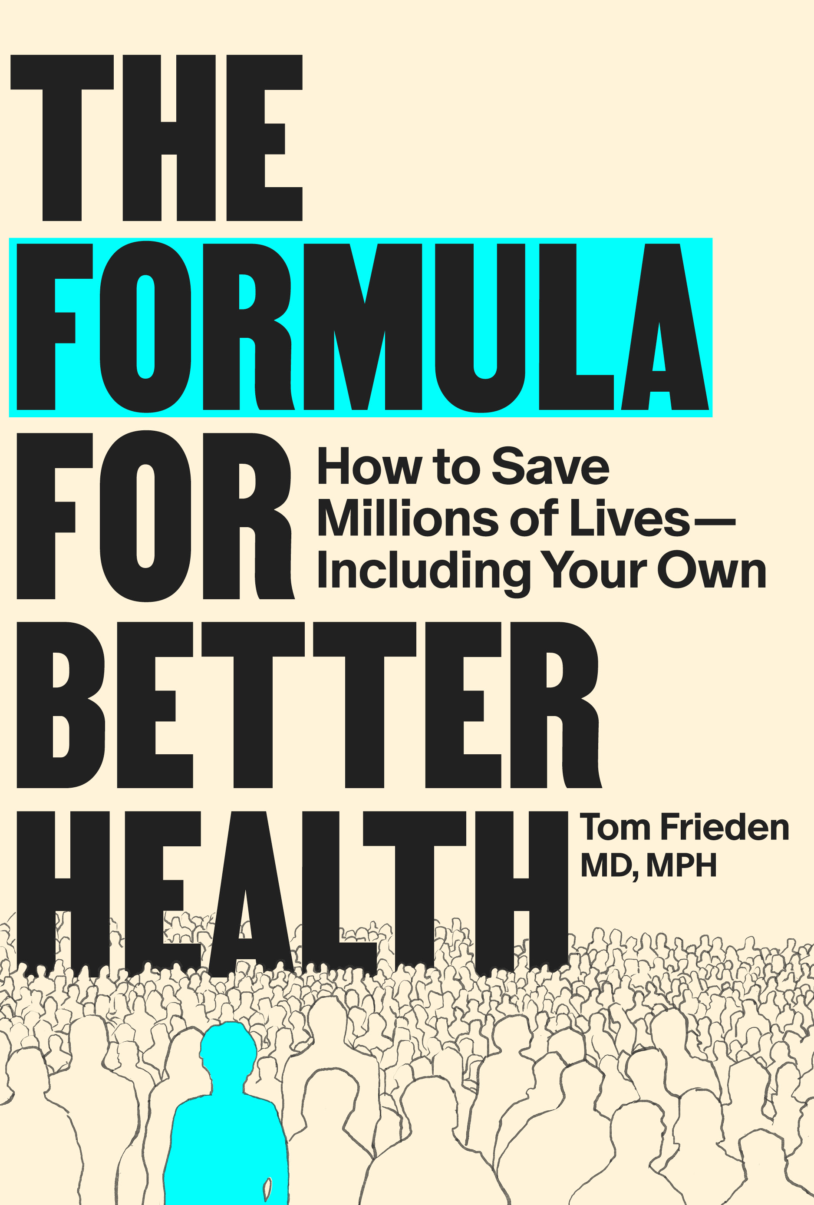
CASE STUDY: SEE / BELIEVE / CREATE
Smoke-Free New York
Politics, Strategy, and Progress Despite Opposition
New York City, 2001–2003 Chapter 8: Progress Despite Opposition
The Formula for Better Health · Tom Frieden · MIT Press, 2025

Slide 2
The Core Political Problem
“Thunder is good, thunder is impressive, but it’s lightning that does the work.” — Mark Twain “In public health, it’s law and regulation that do the work.”
— Mayor Michael Bloomberg
Concentrated Losers
Diffuse Winners
Tobacco industry
Bar/restaurant owners
Immediate, large financial losses
Well-organized and politically connected
Workers protected from secondhand smoke
Nonsmoking patrons and families
Benefits diffuse, future, unquantified
Unorganized—no political structure
vs.
The Formula for Better Health · MIT Press, 2025 · theformulaforbetterhealth.org/formulateaching

Slide 3
A Four-Part Political Framework
Chapter 8: Progress Despite Opposition
Winners & Losers
Deciders & Influencers
Who gains from this policy? Who loses? Why are losers better organized?
Who makes the binding decision? Who shapes that decision-maker?
Advocates & Partnerships
Pragmatism & Timing
Who speaks for the diffuse winners? What coalition makes benefits visible?
When in the political cycle to act? How to meet political constraints without compromising substance?
The Formula for Better Health · MIT Press, 2025 · theformulaforbetterhealth.org/formulateaching

Slide 4
1. Winners & Losers
Why concentrated losses defeat diffuse benefits—and how to overcome this
“Yeah, but not one of those people ever thanked me.” — Mayor Bloomberg, on 35 million lives saved by his philanthropy
01
Map the losers first Identify concentrated, immediate losses—tobacco industry, bar owners. These actors have motive, money, and organization. Their opposition is predictable.
02
Organize the winners Bar workers were diffuse. BREATHE and advocacy coalitions gave them a structure. Martinah Payne-Yehuda gave them a face. Winning requires making diffuse benefits visible and urgent.
03
Measure asymmetry The soda tax faced a bigger, better-organized industry and a weaker winner coalition. Same mayor, same evidence, same city—different political conditions, different outcome.
The Formula for Better Health · MIT Press, 2025 · theformulaforbetterhealth.org/formulateaching

Slide 5
2. Deciders & Influencers
Who makes the binding decision? Who influences them? When is the right moment to act?
Cherner’s Pre-Election Questionnaire Strategy
Before the 2001 election, BREATHE sent written questionnaires to every mayoral and City Council candidate requesting their position on smoke-free workplaces.
Bloomberg and most Council members committed in writing. Cherner published every response publicly.
Result: Reversing a public, written commitment is visible and costly. The record was structural leverage—not rhetoric.
Reach deciders before industry organizes opposition Pre-election, the cost of committing is low. Post-election, organized industry opposition raises the cost of following through. Cherner locked in commitments at the lowest-cost moment.
Bloomberg: an unusual combination of decider and champion He had authority over the health department and had self-financed his election—reducing his dependence on the industries that opposed the law. Identifying deciders who are also champions is the highest-leverage starting point.
The Formula for Better Health · MIT Press, 2025 · theformulaforbetterhealth.org/formulateaching

Slide 6
3. Advocates & Partnerships
Public health agencies cannot advocate for their own programs. Outside advocates are indispensable.
The Triad for Sustained Progress
Strong Government
Proactive Civil Society
Rigorous Monitoring
Bloomberg’s administration set the agenda and provided legal authority. Government alone is too slow and susceptible to political interference.
BREATHE, ALA, ACS, AHA sustained pressure over the two-year campaign and made diffuse benefits visible through organized advocacy.
Data on smoking rates, worker exposure, and health outcomes created accountability and enabled course correction.
The Most Persuasive Witness
Martinah Payne-Yehuda, a pregnant waitress, testified alongside Mayor Bloomberg, Nobel Laureate Harold Varmus, and the health commissioner.
City Council leaders reported her testimony was by far the most powerful. “There simply is no answer to why she had to continue to be exposed and risk her pregnancy so people could smoke in her workplace.”
The Formula for Better Health · MIT Press, 2025 · theformulaforbetterhealth.org/formulateaching

Slide 7
4. Pragmatism & Timing
Do the hard things first. Meet political constraints without compromising substance.
“Nothing doing. If secondhand smoke is killing people today, we ban it today. No delay for bars.”
— Mayor Bloomberg, rejecting a 3-year delay
Do the Hard Things First
Political capital is highest at the start of a new administration. Bloomberg implemented smoke-free bars, a tobacco tax increase, and syringe exchange programs in Term 1, while political capital was greatest and benefits had maximum time to become visible before the next election.
The Smoking Room Compromise: Form vs. Substance
The Problem
The Solution
The Result
City Council speaker demanded smoking rooms as the price of his vote. Real rooms would allow continued worker exposure and block future strengthening of the law.
Allow rooms—but require tuberculosis isolation-level specs: negative pressure, 6 air changes/hr, separate exhaust, no food or drink, 3-year sunset, health dept approval.
Speaker claimed victory. Two bars investigated the requirements. Neither built a room. The law passed intact, protecting all workers.
The Formula for Better Health · MIT Press, 2025 · theformulaforbetterhealth.org/formulateaching

Slide 8
Results: What Happened
Health impact was large. The industry’s economic predictions were wrong.
140K
28%
52%
~8%
fewer smokers in Year 1
adult smoking decline
youth smoking decline
acute MI hospitalizations
21.6% → 19.2% adult smoking rate
over the following decade
over the following decade
Year 1 post-implementation
Why It Succeeded
1
Winners organized (BREATHE, ALA, Payne-Yehuda’s testimony made diffuse benefits visible and urgent)
2
Deciders reached before industry opposition mobilized (pre-election written commitments)
3
Political timing maximized (hard interventions first, Term 1, maximum lead time before election)
4
Political constraint met without compromising substance (smoking room engineering specs)
Frieden TR et al. Adult tobacco use levels after intensive tobacco control measures: New York City, 2002–2003. American Journal of Public Health. 2005 May 24;95(6):1016–23.
Kilgore EA et al. Making it harder to smoke and easier to quit: The effect of 10 years of tobacco control in New York City. American Journal of Public Health. 2014 May 13;104(6):e5–8.
The Formula for Better Health · MIT Press, 2025 · theformulaforbetterhealth.org/formulateaching

Slide 9
The Broader Lesson
Political skill is a form of competence. It is not character, not charisma, not will. The law passed because practitioners applied a rigorous analytical framework:
• Identified winners and losers—and organized the winners
• Reached deciders before industry opposition organized
• Built a coalition that made diffuse benefits visible through testimony
• Found a solution that met a political constraint without compromising the law
• Timed action for maximum political capital
None of this required ‘political will.’
It required political competence.
The Formula for Better Health · Tom Frieden · MIT Press, 2025

