Slide 1
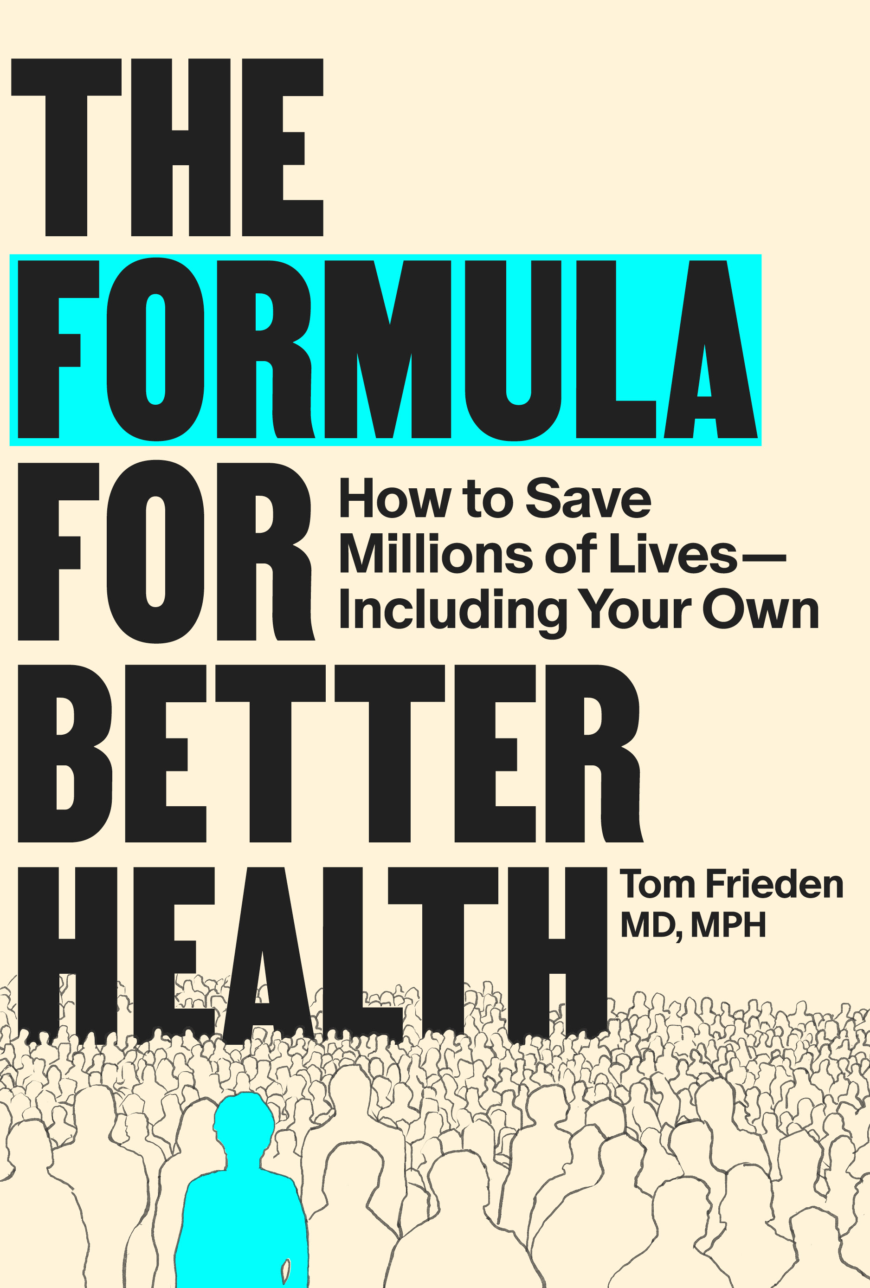
SEE
BELIEVE
CREATE
THE FORMULA FOR BETTER HEALTH · CASE STUDY: EBOLA IN LAGOS
If Ebola arrived in a city of 21 million, what would you predict?
Lagos showed what an effective response can achieve.
The virus that killed more than 11,000 people in West Africa killed 8 in Lagos.
The difference was not biology. It was systems.
Case Study · Ebola in West Africa and Lagos · The Formula for Better Health
The Formula for Better Health · MIT Press, 2025 · theformulaforbetterhealth.net/formulateaching

Slide 2
SEE
BELIEVE
CREATE
THE FORMULA FOR BETTER HEALTH · CASE STUDY: EBOLA IN LAGOS
West Africa 2014–16: When Systems Fail
The first and largest Ebola epidemic in history — and a preventable one
28,000+
11,000+
3 months
cases — the largest
Ebola outbreak ever
deaths across
Guinea, Liberia, Sierra Leone
of undetected spread
before coordinated response
The cascade of system failures:
Late detection
→
Delayed response
→
Fragmented command
→
Incomplete surveillance
→
Community mistrust
→
Uncontrolled spread
Each failure made the next one worse. This was not inevitable — it was the predictable result of system failures.
The Formula for Better Health · MIT Press, 2025 · theformulaforbetterhealth.net/formulateaching

Slide 3
SEE
BELIEVE
CREATE
THE FORMULA FOR BETTER HEALTH · CASE STUDY: EBOLA IN LAGOS
How Control Was Achieved — Eventually
IMS arrived late in West Africa. Thousands of deaths late.
Clear command
Real-time data
Emergency Operations Centers established at national and district level. Single point of accountability.
Daily situation reports identified hotspots. Data drove staffing and treatment-center placement.
Case isolation
Unified partnerships
Investigation teams expanded. Fatality rates fell as access to supportive care improved.
WHO, MSF, CDC aligned under IMS rather than operating in parallel silos.
Safe & dignified burial
Specialized teams trained and equipped. Community engagement reduced resistance.
Critical insight: Systems must be in place before an outbreak, not built during the crisis.
The Formula for Better Health · MIT Press, 2025 · theformulaforbetterhealth.net/formulateaching

Slide 4
SEE
BELIEVE
CREATE
THE FORMULA FOR BETTER HEALTH · CASE STUDY: EBOLA IN LAGOS
Lagos: The High-Risk Test Case
July 20, 2014 — a traveler collapses after arrival at Lagos airport
Why experts feared catastrophe:
What actually happened:
21 million people — one of the world's largest, densest cities
20
total cases
Major international hub with extensive domestic connections
Index case initially misdiagnosed — early exposures multiplied
8
deaths
894 contacts identified across hospital, airport, and community
Resource-constrained health system with limited surge capacity
93
days to containment
October 20, 2014: WHO declared Nigeria Ebola-free.
The Formula for Better Health · MIT Press, 2025 · theformulaforbetterhealth.net/formulateaching

Slide 5
SEE
BELIEVE
CREATE
THE FORMULA FOR BETTER HEALTH · CASE STUDY: EBOLA IN LAGOS
Why Lagos Was Ready: The Polio EOC
Ebola confirmed. Emergency Operations Center activated. Same day.
What Lagos had before Ebola arrived
What West Africa was building mid-crisis
Functioning EOC from polio eradication work
Emergency operations command — weeks
Trained field epidemiology teams
Contact tracing workforce — under pressure
Established data systems and line lists
Lab networks and specimen systems — reactive
Clear command structure and incident management
Partner coordination — improvised
Trusted relationships with communities and partners
Community trust — damaged by early missteps
Build preparedness in peacetime, not during emergencies.
The Formula for Better Health · MIT Press, 2025 · theformulaforbetterhealth.net/formulateaching

Slide 6
SEE
BELIEVE
CREATE
THE FORMULA FOR BETTER HEALTH · CASE STUDY: EBOLA IN LAGOS
SEE: Rapid Detection and Surveillance
Index case confirmed within 5 days. 894 contacts identified. 95%+ daily follow-up.
Immediate recognition
Comprehensive mapping
Clinicians and public health officials recognized the risk and notified authorities within days of the index case's arrival.
894 contacts identified across the hospital, airport, and community — every exposure network traced and documented.
Daily field surveillance
Real-time dashboards
Contact tracers made home visits every day. 95%+ daily follow-up rate sustained throughout the response.
Exposure timelines, transmission chains, and case counts updated daily. Data drove every operational decision.
Surveillance is not administrative overhead — it is the operational backbone of epidemic control.
The Formula for Better Health · MIT Press, 2025 · theformulaforbetterhealth.net/formulateaching

Slide 7
SEE
BELIEVE
CREATE
THE FORMULA FOR BETTER HEALTH · CASE STUDY: EBOLA IN LAGOS
The IMS Structure
IMS answers four questions every day: Who leads? What's the priority? Who does what? Are we winning?
INCIDENT MANAGER
COMMAND
OPERATIONS
PLANNING
LOGISTICS
FINANCE / ADMIN
Strategy, priorities, authority. All roads lead here.
Contact tracing, isolation, infection prevention and control, burials. The doers.
Line lists, forecasts, daily action plans, mapping.
PPE, transport, labs, supplies. Keeps ops moving.
Rapid funds, surge hiring, procurement accountability.
PARTNER COORDINATION — WHO, CDC, MSF, and local NGOs work WITHIN the IMS structure, not parallel to it. This is one of the many things Lagos got right.
Without IMS: confusion about authority, conflicting priorities, duplicated effort, missed cases.
The Formula for Better Health · MIT Press, 2025 · theformulaforbetterhealth.net/formulateaching

Slide 8
SEE
BELIEVE
CREATE
THE FORMULA FOR BETTER HEALTH · CASE STUDY: EBOLA IN LAGOS
IMS in Action: Operations
894 contacts. 95%+ daily follow-up. 93 days to containment.
Day 1
EOC activated same day as Ebola confirmation. Incident Manager designated. No delay, no debate about authority.
894
contacts identified
and traced
Days 1–7
Infection prevention protocols deployed. All hospital contacts identified and monitored.
95%+
daily contact follow-up
rate sustained
Ongoing
894 contacts traced. Daily home visits. Temperature checks. Any symptom → immediate isolation.
0
secondary outbreaks
in Lagos
Throughout
Daily dashboard updated. Partners briefed. Plans revised. Data drove every resource allocation decision.
Community engagement ran in parallel — clear messaging, trusted spokespeople, transparent communication. Trust is an operational asset.
The Formula for Better Health · MIT Press, 2025 · theformulaforbetterhealth.net/formulateaching

Slide 9
SEE
BELIEVE
CREATE
THE FORMULA FOR BETTER HEALTH · CASE STUDY: EBOLA IN LAGOS
See the Path to Progress: The Technical Package
Technical interventions work when embedded in strong operational systems
Contact tracing
Case isolation
Every contact of every case identified, monitored daily, and isolated at first symptom. The 95%+ rate required systems to sustain it.
Rapid isolation broke transmission chains. Supportive care reduced fatality. Standardized IPC protocols protected health workers.
Safe & dignified burial
Real-time data use documenting steady progress
Burial teams reduced community-level transmission while engaging families respectfully — consent and cooperation, not compliance.
Daily situation reports, transmission mapping, and forward planning enabled adaptive management and motivated teams.
Lagos had the right technical package AND the organizational structure to deploy it. Knowledge alone is not enough.
The Formula for Better Health · MIT Press, 2025 · theformulaforbetterhealth.net/formulateaching

Slide 10
SEE
BELIEVE
CREATE
THE FORMULA FOR BETTER HEALTH · CASE STUDY: EBOLA IN LAGOS
CREATE: What Made Lagos Work
Six factors that separated Lagos from the rest of West Africa
1
Pre-existing infrastructure
2
Speed with structure
An EOC system in place for polio was repurposed immediately.
Day 1 activation. No waiting for perfect information. Systems enabled rapid, coordinated action.
3
Unity of command
4
Data-driven operations
Single incident manager. All partners — WHO, CDC, MSF — worked within the structure, not around it.
95%+ contact follow-up because information systems supported field teams. Real-time adaptive management.
5
Community trust
6
Technical package + structure
Transparent communication and cultural sensitivity. Trust is operational, not social — without it, contact tracing fails.
Knowing what to do is not enough. IMS was the operational backbone that turned knowledge into impact.
Same virus. Different systems.
The Formula for Better Health · MIT Press, 2025 · theformulaforbetterhealth.net/formulateaching

Slide 11
SEE
BELIEVE
CREATE
THE FORMULA FOR BETTER HEALTH · CASE STUDY: EBOLA IN LAGOS
Three West African Countries / Lagos
Guinea, Liberia, Sierra Leone
Lagos
11,000+ deaths
More than 3 years
8 deaths
3 months
Why?
The Formula for Better Health · MIT Press, 2025 · theformulaforbetterhealth.net/formulateaching

Slide 12
SEE
BELIEVE
CREATE
THE FORMULA FOR BETTER HEALTH · CASE STUDY: EBOLA IN LAGOS
Same Virus, Different Systems During Initial Outbreak
The virus that killed 11,000 in West Africa killed 8 in Lagos
Feature
West Africa (early)
Lagos
Detection
Slow — weeks to months delayed
Immediate — 5 days to confirmation
Command
Fragmented, unclear authority
Unified IMS from Day 1
Contact tracing
Incomplete, reactive
894 contacts, 95%+ daily follow-up
Infection control
Inconsistent
Rapid deployment, standardized
Community trust
Low — damaged by early missteps
Higher — transparent communication
Partner roles
Parallel, competing silos
Integrated under national IMS
Outcome
28,000+ cases, 11,000+ deaths
20 cases, 8 deaths — contained
The Formula for Better Health · MIT Press, 2025 · theformulaforbetterhealth.net/formulateaching

Slide 13
SEE
BELIEVE
CREATE
THE FORMULA FOR BETTER HEALTH · CASE STUDY: EBOLA IN LAGOS
8 Principles of Epidemic Preparedness
1
Speed saves lives — every day of delay enables exponential growth
5
Systems determine outcomes — same virus, different systems, different results
2
Structure enables speed — you cannot move fast in chaos
6
IMS scales from villages to megacities — structure is universal
3
Data must flow in real time
7
Build before crisis strikes — preparedness is an investment, not an expense
4
Trust is operational, not social — without it, treatment programs and contact tracing fails
8
Unity of command is not negotiable — fragmented authority produces fragmented response
Ready systems determine outcomes.
The Formula for Better Health · MIT Press, 2025 · theformulaforbetterhealth.net/formulateaching

Slide 14
SEE
BELIEVE
CREATE
THE FORMULA FOR BETTER HEALTH · CASE STUDY: EBOLA IN LAGOS
DISCUSSION
Question 1
Why Did Lagos React Differently?
What specific conditions allowed Lagos to activate IMS on Day 1 when West Africa took weeks or months?
The polio EOC was decisive. What does this tell us about the relationship between different disease programs and pandemic preparedness?
Could a country without this pre-existing infrastructure replicate the Lagos response? What would need to be true?
The Formula for Better Health · MIT Press, 2025 · theformulaforbetterhealth.net/formulateaching

Slide 15
SEE
BELIEVE
CREATE
THE FORMULA FOR BETTER HEALTH · CASE STUDY: EBOLA IN LAGOS
DISCUSSION
Question 2
Data as a Strategic Resource
Lagos achieved 95%+ daily contact follow-up. What had to be true about the information system to make that possible?
West Africa's early response was hampered by incomplete line lists and fragmented data. What does this tell us about surveillance as an operational, not just epidemiological, tool?
How does the Lagos data story connect to the See component of See/Believe/Create?
The Formula for Better Health · MIT Press, 2025 · theformulaforbetterhealth.net/formulateaching

Slide 16
SEE
BELIEVE
CREATE
THE FORMULA FOR BETTER HEALTH · CASE STUDY: EBOLA IN LAGOS
DISCUSSION
Question 3
Systems Determine Outcomes
The same virus killed 11,000 in West Africa and 8 in Lagos. How would you explain this to a politician who thinks the answer is 'more money'?
IMS does not replace contact tracing, lab work, or community engagement — it makes all of them more coherent. What does this tell us about the relationship between technical interventions and organizational structure?
If you were advising a Minister of Health in a country that has never used IMS, what would you prioritize in the first year?
The Formula for Better Health · MIT Press, 2025 · theformulaforbetterhealth.net/formulateaching

