Slide 1
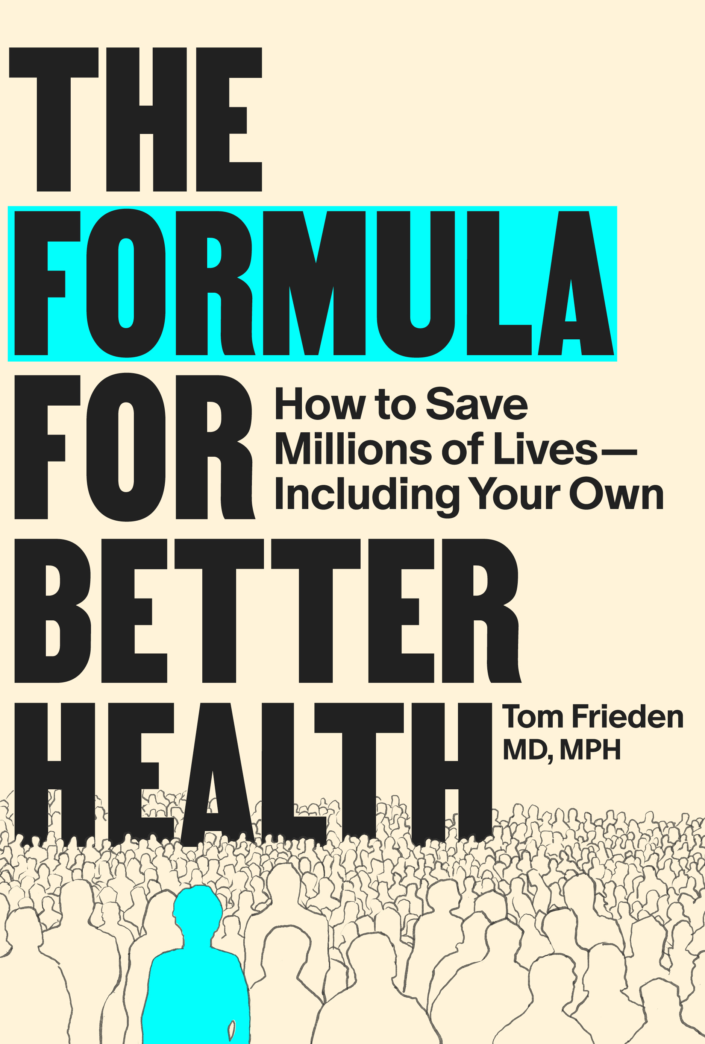
THE FORMULA FOR BETTER HEALTH · CASE STUDY: COMMUNICATE
Ebola in Guinea
Communication as a Public Health Intervention
SEE
BELIEVE
CREATE
“Ebola is real!”
Chapter 7 · The Formula for Better Health · MIT Press, 2025
The Formula for Better Health · MIT Press, 2025 · theformulaforbetterhealth.net/formulateaching

Slide 2
SEE
BELIEVE
CREATE
THE FORMULA FOR BETTER HEALTH · CASE STUDY: COMMUNICATE
Guinea, 2014: Trust Was the Missing Ingredient
~50%
~11,000
"You say you're doctors, but you've been here for eighteen months and you haven't treated a single patient."
of Ebola patients
died from the disease
deaths in West Africa
from the 2014 outbreak
— Communities in Guinea, reported by Dr. Abdou Salam Gueye
Traditional burial practices — washing, dressing, holding the body — drove transmission.
Community cooperation was not optional. It was essential to stopping the epidemic.
The problem was not the virus. It was trust.
Bell BP, Damon IK, Jernigan DB, et al. Overview, Control Strategies, and Lessons Learned in the CDC Response to the 2014–2016 Ebola Epidemic. MMWR Suppl 2016;65(Suppl-3):4–11. DOI: http://dx.doi.org/10.15585/mmwr.su6503a2
The Formula for Better Health · MIT Press, 2025 · theformulaforbetterhealth.net/formulateaching

Slide 3
SEE
BELIEVE
CREATE
THE FORMULA FOR BETTER HEALTH · CASE STUDY: COMMUNICATE
Accurate Messages That Made Things Worse
Factually correct. Catastrophic implications.
"Don't eat bushmeat."
"Ebola can’t be cured."
True at the epidemic's origin. By this point, person-to-person transmission was the primary route — bushmeat was irrelevant. Communities heard blame, not guidance.
Also true. Also cooperation-destroying. If nothing can be done, why report a sick family member? The message eliminated the rational basis for engaging with the response.
A message must be accurate, relevant, and structured to produce the right behavior.
The Formula for Better Health · MIT Press, 2025 · theformulaforbetterhealth.net/formulateaching

Slide 4
SEE
BELIEVE
CREATE
THE FORMULA FOR BETTER HEALTH · CASE STUDY: COMMUNICATE
The Correction: Simple, True, Actionable
"Ebola is real."
1
2
3
Simple
True
Actionable
Spread person to person without translation or explanation
Said nothing false, made no promises it could not keep
Opened the door: Ebola is real — and here is what we can do
Safe and dignified burial acknowledged community grief — and changed behavior surveillance alone could not reach.
The Formula for Better Health · MIT Press, 2025 · theformulaforbetterhealth.net/formulateaching

Slide 5
SEE
BELIEVE
CREATE
THE FORMULA FOR BETTER HEALTH · CASE STUDY: COMMUNICATE
The Right Messenger: Terrie Hall
The messenger is not a delivery mechanism. The messenger is the message.
BACKGROUND
DIAGNOSIS
THE MESSAGE
THE IMPACT
Grew up in North Carolina. Worked on a tobacco farm. Cheered at her high school. Smoked two packs a day.
At 40, developed oral and throat cancer. Grueling radiation and chemotherapy.
Volunteered to tell her story in CDC's Tips from Former Smokers campaign. Fierce and funny — credible in a way no official could be.
The day before she died, at 53, she insisted on filming a final message. Her story helped tens of thousands quit.
Research shows graphic personal testimonials motivate cessation more than showing death or abstract health benefits.
The Formula for Better Health · MIT Press, 2025 · theformulaforbetterhealth.net/formulateaching

Slide 6
SEE
BELIEVE
CREATE
THE FORMULA FOR BETTER HEALTH · CASE STUDY: COMMUNICATE
The Right Messenger: Christian Nwigwe
Trust crossed barriers that information could not.
WHAT FAILED
WHAT WORKED
The physician — with passable Spanish
Nwigwe — Nigerian-born, no Spanish
Medical credentials and authority
Former salesman, TB outreach worker
Accurate clinical information
No common language
Explanation of why treatment mattered
Deep caring, consistency — provided lunch, week after week
After nine months, Jorge was cured. The trust Nwigwe built was itself the intervention.
The Formula for Better Health · MIT Press, 2025 · theformulaforbetterhealth.net/formulateaching

Slide 7
SEE
BELIEVE
CREATE
THE FORMULA FOR BETTER HEALTH · CASE STUDY: COMMUNICATE
Three Ways to Communicate Effectively
1
2
3
Right Message
Right Messenger
Right Audience — and Evolve
Simple, true, actionable. "Ebola is real" succeeded where accurate but counterproductive messages failed — because it created a basis for cooperation.
Trusted community leaders, not outside experts. Terrie Hall and Christian Nwigwe show that the right messenger's credibility often comes from shared experience, not credentials.
Perceptions change. "Is Ebola real?" becomes "Will the treatment unit kill me?" becomes "Will you protect my family?" The strategy must track changes with the same discipline as epidemiological data.
Communication is not support for a public health intervention. Communication is the intervention.
The Formula for Better Health · MIT Press, 2025 · theformulaforbetterhealth.net/formulateaching

Slide 8
SEE
BELIEVE
CREATE
THE FORMULA FOR BETTER HEALTH · CASE STUDY: COMMUNICATE
DISCUSSION
Questions 1–2
Accuracy and the Right Message
Both early Ebola messages — “don’t eat bushmeat” and “Ebola cannot be cured” — were factually accurate. Why did they make the epidemic worse?
What does this reveal about the relationship between accuracy and effective public health communication?
What principles does “Ebola is real” illustrate that the earlier messages violated?
The Formula for Better Health · MIT Press, 2025 · theformulaforbetterhealth.net/formulateaching

Slide 9
SEE
BELIEVE
CREATE
THE FORMULA FOR BETTER HEALTH · CASE STUDY: COMMUNICATE
DISCUSSION
Question 3
The Right Messenger
Terrie Hall and Christian Nwigwe succeeded as messengers for very different audiences. What made each effective?
What do their examples suggest about who carries credibility — and why?
What are the implications for how public health programs should identify and support their messengers?
The Formula for Better Health · MIT Press, 2025 · theformulaforbetterhealth.net/formulateaching

Slide 10
SEE
BELIEVE
CREATE
THE FORMULA FOR BETTER HEALTH · CASE STUDY: COMMUNICATE
DISCUSSION
Question 4
Communication as Intervention
The case frames communication as itself part of the intervention — not just support for it. Do you agree?
What are the practical implications for how a program is designed, staffed, and evaluated?
What accountability mechanisms would hold communication to the same standard as contact tracing?
The Formula for Better Health · MIT Press, 2025 · theformulaforbetterhealth.net/formulateaching

Slide 11
SEE
BELIEVE
CREATE
THE FORMULA FOR BETTER HEALTH · CASE STUDY: COMMUNICATE
DISCUSSION
Question 5
The Discipline to Evolve
Community perceptions changed throughout the epidemic. What systems would you put in place to know when your messages needed to change?
What data would you collect? How often? Who decides when to change the message?
What does this case suggest about how programs should measure whether their communication is working?
The Formula for Better Health · MIT Press, 2025 · theformulaforbetterhealth.net/formulateaching

